Slide 1
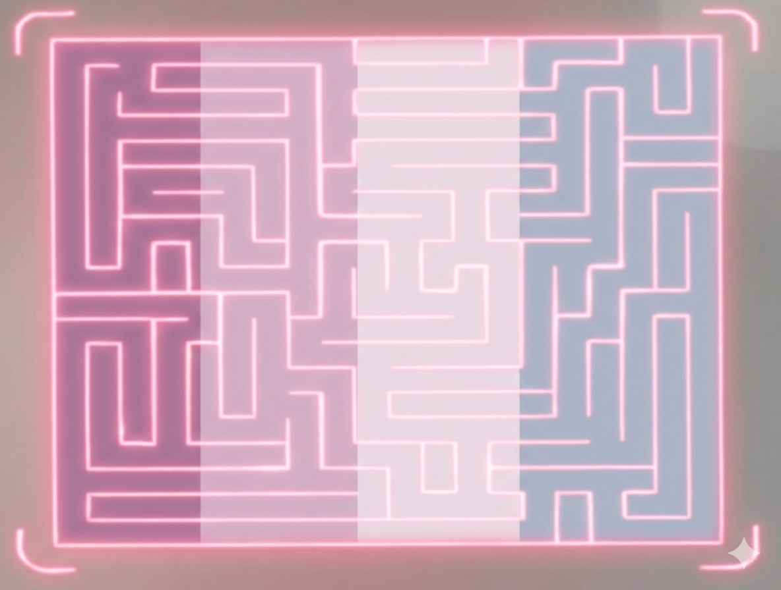
MicroMouse
Robot
Autonomous Maze-Solving Robot
ESP32 · LiDAR · Flood-Fill BFS · PD Control · WiFi
Team : Aya Fares, Nagham Massis, Alzahra Nassif, Marah Hamarsheh
Supervised by: Dr. Wasel Ghanam
Interfacing Techniques · Academic Year 2025–2026 · February 28 2026
Notes:
Title slide. MicroMouse autonomous maze-solving robot project — Interfacing Techniques course 2025–2026.

Slide 2
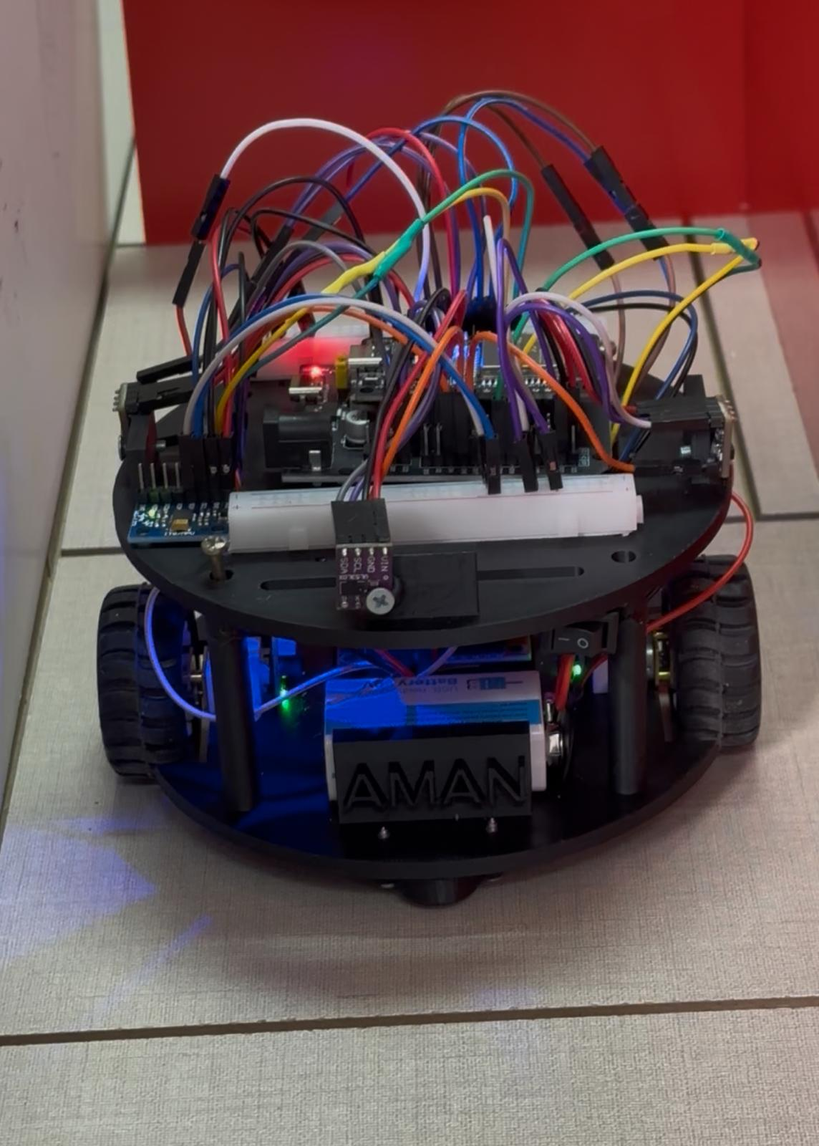
Project Overview
What is MicroMouse? What did we set out to build?
What is MicroMouse?
An autonomous robot that navigates and solves an unknown 16×16 maze as fast as possible. A classic IEEE robotics competition since 1977. No human control once started.
3 VL53L0X LiDAR sensors
Flood-Fill BFS algorithm
PD motor control loops
ESP32 dual I²C bus setup
Gyroscope accurate turns
Live WiFi tuning dashboard
MicroMouse System
2
Notes:
Project overview: what MicroMouse is and our 6 core technical goals.

Slide 3
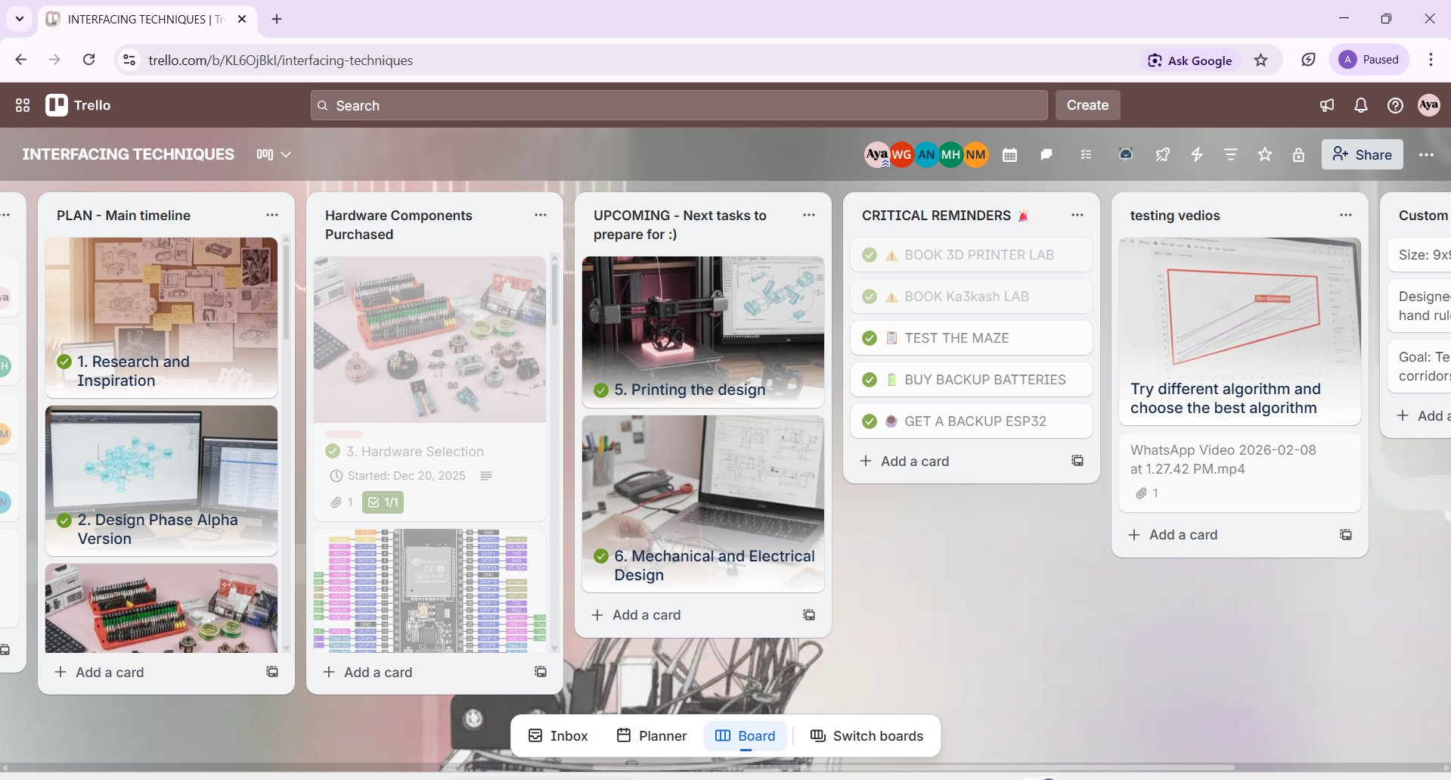
Project Management — Trello Board
How we organized our entire workflow
PLAN — Main Timeline
6 phases tracked end-to-end
Hardware Components
All parts with photos & receipts
UPCOMING Next Tasks
Always-visible next actions
CRITICAL REMINDERS
Lab bookings, backups, tests
Testing Videos
Algorithm comparison recordings
3
Notes:
Trello was used to manage the entire project. Show how each list tracked a different aspect of the workflow.

Slide 4
Project Timeline — 6 Phases
December 2025 → February 2026
Dec 25
Dec 25
Dec 25
Jan 26
Jan 26
Feb 26
01
02
03
04
05
06
Research
Design
Hardware
3D Printing
Mechanical
Software & Test
Studied MicroMouse competitions, algorithms, sensor options
Designed the alpha version and optimized robot geometry using Autodesk Fusion.
Component evaluation & purchase. All 10 parts selected
Booked lab, printed chassis, motor mounts, sensor brackets
Wiring, I²C buses, motor driver, PCB layout
Flood-Fill, PD control, WiFi dashboard, full maze tests
4
Notes:
6 phases from December 2025 to February 2026. Each phase tracked on Trello.

Slide 5
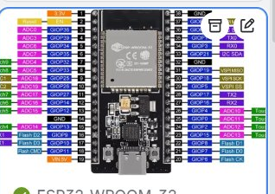
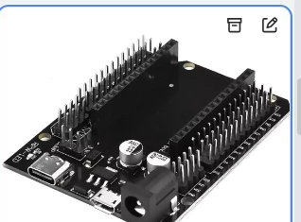
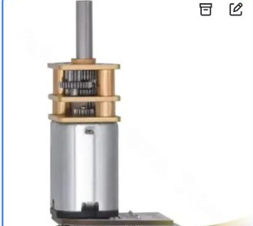
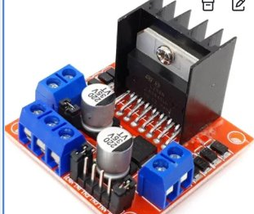
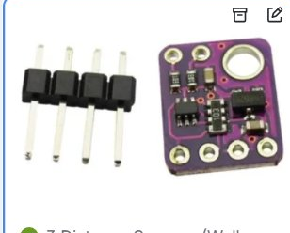
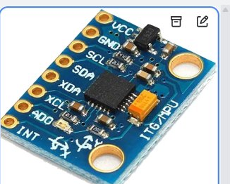
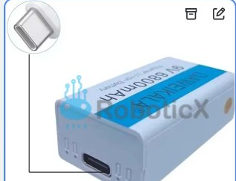
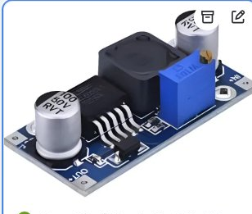
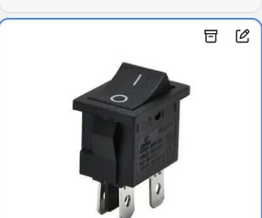
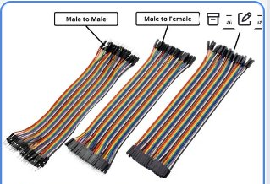
Hardware Components — Complete Bill of Materials
All 10 components selected, purchased and verified
ESP32-WROOM-32
ESP32 Expansion Shield
DC Gear Motor + Encoder
L298N Motor Driver
VL53L0X LiDAR × 3
Microcontroller
Pin Breakout Board
Drive System × 2
H-Bridge PWM Control
Time-of-Flight Sensor
MPU6050 IMU
Li-ion Battery 9V
DC-DC Boost Converter
On/Off Power Switch
Jumper Wires
Gyroscope + Accel
Rechargeable Power
Voltage Regulator
Power Control
M-M / M-F / F-F Connections
5
Notes:
All 10 hardware components with photos. Each tracked as a card in the Trello Hardware Components list.

Slide 6
ESP32-WROOM-32 Microcontroller
The brain: dual-core 240MHz, WiFi, dual I²C buses, PWM
Dual-Core 240 MHz
Built-in WiFi
Runs Flood-Fill + WiFi server simultaneously without lag
Hosts async web server, live PID dashboard, no extra module
Dual I²C Buses
HW Interrupt Pins
Bus 0 → MPU6050 (GPIO 19/18). Bus 1 → 3× LiDAR (GPIO 5/17)
GPIO 33/32 and 34/35 count encoder pulses at high frequency
Expansion Shield
for clean pin access
PWM (LEDC)
3.3V Logic — Critical
GPIO 13, 25, 26 generate PWM for L298N motor speed control
All sensors/drivers must stay ≤3.3V. Exceeded → burned chip!
6
Notes:
ESP32 is the central MCU. Key features: dual-core, WiFi, dual I²C, hardware interrupts for encoders, PWM for motors. The 3.3V limit is critical — we burned one unit by exceeding it.

Slide 7
Component — VL53L0X LiDAR Sensors × 3
The eyes: Time-of-Flight laser ranging for wall detection
Sensor Technology Comparison
Property | IR Sensor | Ultrasonic | VL53L0X
Accuracy | ±10–50 mm | ±5 mm | ±1–2 mm
Field of View | Wide / noisy | Wide / echo | Narrow 25°
Light Immune | No | Yes | Yes
I²C Interface | No | No | Yes
Best For | Simple presence | Open space | Precise walls
Detects wall ahead. Triggers stop or turn decision. Threshold: < 150mm = wall present.
Checks left wall. Decides if left turn is possible. XSHUT pin cycles address at boot.
Checks right wall. All 3 share I²C Bus 1 with unique addresses assigned via XSHUT pins.
FRONT
FRONT SENSOR
LEFT SENSOR
RIGHT SENSOR
ROBOT
LEFT
RIGHT
7
Notes:
Three VL53L0X LiDAR sensors provide wall detection front, left, and right. LiDAR was chosen over IR/ultrasonic for its ±1–2mm accuracy and clean I²C interface.

Slide 8

Component — Motors, Encoders & Motor Driver
Locomotion: DC gear motors + quadrature encoders + L298N H-bridge
Quadrature Encoders
4 pins (A+B per motor) → ESP32 GPIO 33/32 & 34/35. Interrupt-driven pulse counting for precise odometry.
H-Bridge Direction
IN1–IN4 pins control forward/reverse per motor independently. Each motor fully bidirectional at all speeds.
PWM Speed Control
DC Gear Motor
+ Quadrature Encoder
L298N Dual
Motor Driver
ESP32 LEDC peripheral generates PWM on GPIO 13, 25, 26. Duty cycle 0–100% controls velocity smoothly.
PD Control Loop
Encoder
Counts
Speed
Error
P+D
Correction
PWM
Output
Straight
Motion
Overvoltage Lesson
Motor back-EMF spikes back-fed into ESP32 logic pins. After burn-out, added 100nF bypass capacitors on PWM lines.
8
Notes:
Two DC gear motors with quadrature encoders provide drive and odometry. L298N H-bridge handles bidirectional PWM. PD controller equalizes wheel speeds using encoder feedback.

Slide 9
Component — IMU & Power System
MPU6050 gyroscope + Li-ion battery + boost converter + switch
MPU6050 IMU
Li-ion 9V Battery
DC-DC Converter
Power Switch
MPU6050 — Gyroscope & Accelerometer
Li-ion Rechargeable 9V Battery
I²C Bus 0 (GPIO 19/18). Provides gyroZ_raw → accumulated over time to track currentYaw. Enables accurate 90°/180° turns without encoder wheel-slip drift. Also provides accelerometer for motion state detection.
Main power source for the entire robot. USB-C charging. Stable current delivery during motor load spikes. We kept backup batteries after the burn-out incident (tracked on Trello Critical Reminders).
Step-Up DC-DC Boost Converter
On/Off Rocker Switch
Adjustable output voltage. Regulates battery voltage to stable levels for motors and logic rails. Protects ESP32's 3.3V logic rail from motor voltage fluctuations and back-EMF spikes.
Inline with battery circuit. Allows safe power on/off without disconnecting wires. Critical for our staged power-on testing protocol — always verify voltages before connecting ESP32.
9
Notes:
IMU provides gyroscope data for accurate turning. Power system includes battery, boost converter for stable voltage, and a switch for safe power-on procedures.

Slide 10
Mechanical Design & 3D Printing
Phase 4 & 5: chassis, sensor mounts, motor brackets, final assembly
Design Specifications
Size
Material
13X13 cm footprint - fits maze that it size 19.5x19.5
PLA plastic — rigid, lightweight, printable
Drive
Sensors
2 DC motors, rear-positioned, differential drive
Front center + left/right 45° angled LiDAR mounts
Weight
PCB
Minimized — faster acceleration & turning
ESP32 shield top-center for WiFi antenna clearance
Battery
Switch
Li-ion mounted low for stable center of gravity
Accessible on chassis side for safe power-on
15
Notes:
Mechanical design used CAD + 3D printing. Two iterations needed for correct motor mount tolerances. Lab bookings tracked on Trello.

Slide 11

System Overview — All Components & Wiring
Every GPIO connection from the actual code
VL53L0X FRONT
Motor A + Encoder A
XSHUT→GPIO 16 | I²C addr 0x30
ENA=25 IN1=27 IN2=14 | ENC_A1=32 ENC_A2=33
VL53L0X LEFT
Motor B + Encoder B
XSHUT→GPIO 17 | I²C addr 0x31
ENB=26 IN3=12 IN4=13 | ENC_B1=18 ENC_B2=19
VL53L0X RIGHT
L298N Motor Driver
XSHUT→GPIO 4 | I²C addr 0x32
spinRight/Left/setForward | turnPWM=85
MPU6050 IMU
Li-ion + Boost + SW
ESP32-WROOM-32
Wire.begin(21, 22) — I²C SDA/SCL
9V battery → DC-DC regulator → power switch
Dual-Core 240MHz | WiFi
10

Slide 12
Complete Pinout
Every ESP32 GPIO connection verified against #define constants in the firmware
Component | GPIO Pin(s) | Protocol | Function (from code)
I²C — MPU6050 IMU
MPU6050 SDA | GPIO 21 | I²C (Wire.begin) | IMU data line — Wire.begin(21, 22)
MPU6050 SCL | GPIO 22 | I²C (Wire.begin) | IMU clock line — Wire.begin(21, 22)
I²C — VL53L0X LiDAR × 3 (shared bus)
LiDAR SDA (all 3) | GPIO 21 | I²C (Wire) | All 3 sensors share same I²C bus as MPU6050
LiDAR SCL (all 3) | GPIO 22 | I²C (Wire) | Same Wire bus — unique addresses via XSHUT
XSHUT FRONT | GPIO 16 | Digital Output | XSHUT_FRONT — boots sensor, assigns 0x30
XSHUT LEFT | GPIO 17 | Digital Output | XSHUT_LEFT — boots sensor, assigns 0x31
XSHUT RIGHT | GPIO 4 | Digital Output | XSHUT_RIGHT — boots sensor, assigns 0x32
MicroMouse · Interfacing Techniques · Pinout

Slide 13
Continue - Pinout
Component | GPIO Pin(s) | Protocol | Function (from code)
Encoders — Quadrature (IRAM_ATTR ISRs)
Left Encoder ISR | GPIO 32 | Interrupt (RISING) | ENC_A1 — RISING edge triggers encoderA_ISR
Left Encoder Dir | GPIO 33 | Digital Input | ENC_A2 — read in ISR: HIGH=forward LOW=back
Right Encoder ISR | GPIO 18 | Interrupt (RISING) | ENC_B1 — RISING edge triggers encoderB_ISR
Right Encoder Dir | GPIO 19 | Digital Input | ENC_B2 — read in ISR: HIGH=forward LOW=back
Motor Driver L298N — Speed + Direction
Motor A Speed (ENA) | GPIO 25 | PWM analogWrite | ENA — Motor A speed 0–255 duty cycle
Motor A Dir IN1 | GPIO 27 | Digital Output | IN1 — setForward: LOW | spinRight: HIGH
Motor A Dir IN2 | GPIO 14 | Digital Output | IN2 — setForward: HIGH | spinRight: LOW
Motor B Speed (ENB) | GPIO 26 | PWM analogWrite | ENB — Motor B speed 0–255 duty cycle
Motor B Dir IN3 | GPIO 12 | Digital Output | IN3 — setForward: LOW | spinLeft: HIGH
Motor B Dir IN4 | GPIO 13 | Digital Output | IN4 — setForward: HIGH | spinLeft: LOW

Slide 14

Algorithm Selection — Evaluating 4 Approaches
Why we chose Flood-Fill BFS for unknown maze navigation
Wall Follower
Dijkstra / A*
Flood-Fill BFS
Rejected
Rejected
CHOSEN ✓
Pros:
Pros:
Pros:
Simple to code
Optimal path
Only 16×16 int array
Very low memory
Works on known maps
Dynamic — adapts to new walls
Fast BFS re-flood
Cons:
Cons:
Efficient on microcontroller
– Gets stuck in loops
– Needs full map
Explores unknown maze well
– Cannot solve all maze types
– Heavy for ESP32 RAM
– Non-optimal path
– Not for unknown maze
Cons:
– Re-floods on new wall
– Slightly complex code
11
Notes:
Four algorithms compared. Flood-Fill was chosen for its efficiency, dynamic adaptability, and minimal memory use — perfect for unknown-maze navigation on a constrained MCU.

Slide 15
Pin Definitions
Every #define and global variable declaration
Motor A: ENA + IN1/IN2
Motor B: ENB + IN3/IN4
/* ====== MOTOR PINS ====== */
#define ENA 25 // Motor A speed (PWM)
#define IN1 27 // Motor A direction
#define IN2 14
#define ENB 26 // Motor B speed (PWM)
#define IN3 12 // Motor B direction
#define IN4 13
/* ====== ENCODER PINS ====== */
#define ENC_A1 32 // ISR trigger (RISING)
#define ENC_A2 33 // direction pin
#define ENC_B1 18 // ISR trigger (RISING)
#define ENC_B2 19 // direction pin
/* ====== XSHUT PINS ====== */
#define XSHUT_FRONT 16
#define XSHUT_LEFT 17
#define XSHUT_RIGHT 4
/* ====== GLOBALS ====== */
volatile long countA = 0, countB = 0;
float gz_bias = 0.0f;
float yaw = 0.0f;
int posX = 0, posY = 0;
int heading = NORTH;
→ ENA GPIO 25 → analogWrite() PWM speed control
→ ENB GPIO 26 → analogWrite() PWM speed control
→ IN1 GPIO 27 + IN2 GPIO 14 → forward/reverse
→ IN3 GPIO 12 + IN4 GPIO 13 → forward/reverse
→ setForward(): IN1=LOW, IN2=HIGH
→ setForward(): IN3=LOW, IN4=HIGH
→ spinRight(): IN1=HIGH, IN2=LOW
→ spinLeft(): IN3=HIGH, IN4=LOW
Encoders — IRAM_ATTR ISR
LiDAR XSHUT — Address Boot
→ ENC_A1 GPIO 32 → RISING edge triggers encoderA_ISR
→ GPIO 16 FRONT → init() → setAddress(0x30)
→ ENC_A2 GPIO 33 → read for direction: HIGH=++ LOW=--
→ GPIO 17 LEFT → init() → setAddress(0x31)
→ ENC_B1 GPIO 18 → RISING edge triggers encoderB_ISR
→ GPIO 4 RIGHT → init() → setAddress(0x32)
→ ENC_B2 GPIO 19 → direction for Motor B
→ All 3: setTimeout(250) ms

Slide 16
Encoder ISRs & Gyroscope Calibration
IRAM_ATTR interrupt handlers + 800-sample calibrateGyro()
IRAM_ATTR — Why Critical
// Encoder ISRs — stored in IRAM
void IRAM_ATTR encoderA_ISR(){
if (digitalRead(ENC_A2)) countA++;
else countA--;
}
void IRAM_ATTR encoderB_ISR(){
if (digitalRead(ENC_B2)) countB++;
else countB--;
}
IRAM_ATTR places the ISR in internal SRAM. Without it, ESP32's flash cache misses during WiFi/SPI activity cause the ISR to stall — losing encoder pulses at high speed. Essential for reliable tick counting.
Quadrature Direction Logic
On every RISING edge of ENC_A1, the ISR immediately reads ENC_A2:
• HIGH → wheel moving forward → countA++
• LOW → wheel moving backward → countA--
Same logic mirrors for Motor B via ENC_B2.
void calibrateGyro() {
const int N2 = 800;
float sum = 0;
for(int i=0; i<N2; i++){
sum += readGz();
delay(3); // 800 × 3ms = 2.4s
}
gz_bias = sum / N2;
}
// In loop — integrate yaw every tick:
float gz = readGz() - gz_bias;
yaw += gz * dt; // rad/s × seconds
Gyro Calibration — 800 samples
800 samples × 3ms delay = 2.4 seconds of robot stillness at startup. Averages raw gz readings to compute gz_bias. Every future readGz() call subtracts this bias to eliminate zero-offset drift.
Yaw Integration
Each loop: float gz = readGz() - gz_bias; yaw += gz * dt;
The dt guard (if dt < 0.005f return) ensures minimum 5ms between corrections — prevents noise amplification from extremely fast dt values.
4

Slide 17
LiDAR Setup - setupSensors() with XSHUT Cycling
All 3 VL53L0X sensors start at address 0x29 — sequential boot assigns unique addresses
void setupSensors() {
pinMode(XSHUT_FRONT, OUTPUT);
pinMode(XSHUT_LEFT, OUTPUT);
pinMode(XSHUT_RIGHT, OUTPUT);
// Pull ALL sensors into hardware reset
digitalWrite(XSHUT_FRONT, LOW);
digitalWrite(XSHUT_LEFT, LOW);
digitalWrite(XSHUT_RIGHT, LOW);
delay(10);
// Wake FRONT, init, assign 0x30
digitalWrite(XSHUT_FRONT, HIGH); delay(10);
frontSensor.init();
frontSensor.setAddress(0x30);
// Wake LEFT, init, assign 0x31
digitalWrite(XSHUT_LEFT, HIGH); delay(10);
leftSensor.init();
leftSensor.setAddress(0x31);
// Wake RIGHT, init, assign 0x32
digitalWrite(XSHUT_RIGHT, HIGH); delay(10);
rightSensor.init();
rightSensor.setAddress(0x32);
frontSensor.setTimeout(250);
leftSensor.setTimeout( 250);
rightSensor.setTimeout(250);
}
Why Sequential Booting?
All 3 VL53L0X sensors share the same default I²C address (0x29). XSHUT = LOW forces hardware reset, keeping a sensor silent. Only the active sensor is visible on the bus during address assignment.
1
ALL → RESET (LOW)
All 3 XSHUT pins pulled LOW simultaneously. All sensors enter hardware reset — none respond to I²C.
2
FRONT → HIGH (0x30)
Only FRONT wakes up. frontSensor.init() communicates at default 0x29. setAddress(0x30) → FRONT now lives at 0x30 permanently.
3
LEFT → HIGH (0x31)
LEFT wakes up. leftSensor.init() at 0x29 (FRONT is at 0x30, no collision). setAddress(0x31) → LEFT locked at 0x31.
4
RIGHT → HIGH (0x32)
RIGHT wakes up. rightSensor at 0x29. setAddress(0x32). Now all 3 sensors on same bus: 0x30, 0x31, 0x32. setTimeout(250ms) each.
5

Slide 18
Flood-Fill — initFlood(), floodFill(),
selectDirection()
int selectDirection(x,y,h){
int bestDir=-1,bestF=9999;
int bestUnk=-1,fallback=-1;
// prev cell = avoid backtrack
int px=x-dirs[h][0];
for(d=0; d<4; d++){
if(!isAccessible...) skip;
if(nx==px&&ny==py){
fallback=d; continue;
}
int fval=flood[nx][ny];
int unk =unknownScore(nx,ny);
if(fval<bestF ||
(fval==bestF && unk>bestUnk))
bestDir=d; // pick it
}
if(bestDir==-1) return fallback;
}
8×8 maze with 4 goal cells at (3,3)(3,4)(4,3)(4,4)
void initFlood() {
for(x=0;x<8;x++) for(y=0;y<8;y++){
int d = 9999;
for(i=0;i<4;i++) // 4 goals
d=min(d,abs(x-gx)+abs(y-gy));
flood[x][y] = d;
}
// Override: goals = 0
flood[3][3]=flood[3][4]=0;
flood[4][3]=flood[4][4]=0;
}
8×8 Flood Grid — Manhattan dist to 4 goals
6
5
4
3
3
4
5
6
5
4
3
2
2
3
4
5
4
3
2
1
1
2
3
4
3
2
1
G
G
1
2
3
3
2
1
G
G
1
2
3
4
3
2
1
1
2
3
4
5
4
3
2
2
3
4
5
void floodFill() {
bool changed = true;
while(changed) {
changed = false;
for each cell (x,y):
if(!isConsistent(x,y)){
makeConsistent(x,y);
changed = true;
}
} // repeat until stable
}
S
5
4
3
3
4
5
6
Counts walls not yet set for a cell (N/E/S/W).
+1 for each wall not in maze[x][y]
Higher score → more unknown area → higher exploration priority
selectDirection: choose lowest flood value first, then highest unknown score if tied.
unknownScore(x,y)
S=Start(0,0) G=Goals(3-4,3-4) GOAL_CELLS[4][2]={{3,3},{3,4},{4,3},{4,4}}
· 6

Slide 19
senseWalls() — LiDAR Reading → Maze Map Update
Translating sensor readings to cardinal wall directions based on heading
Wall Bitmask — maze[x][y]
void senseWalls(int x, int y, int h) {
int fD = readFrontDistance();
int lD = readLeftDistance();
int rD = readRightDistance();
bool wallF = (fD < wallThresholdFront); // 100mm
bool wallL = (lD < wallThresholdSide); // 120mm
bool wallR = (rD < wallThresholdSide); // 120mm
if(wallF){
if(h==NORTH) setWall(x,y,N_WALL);
if(h==EAST) setWall(x,y,E_WALL);
if(h==SOUTH) setWall(x,y,S_WALL);
if(h==WEST) setWall(x,y,W_WALL);
}
if(wallL){ // left→west if NORTH
if(h==NORTH) setWall(x,y,W_WALL);
if(h==EAST) setWall(x,y,N_WALL);
if(h==SOUTH) setWall(x,y,E_WALL);
if(h==WEST) setWall(x,y,S_WALL);
}
if(wallR){ /* mirror of wallL */ }
}
Define | Value | Meaning
N_WALL | 1 (0001) | North ↑ wall
E_WALL | 2 (0010) | East → wall
S_WALL | 4 (0100) | South ↓ wall
W_WALL | 8 (1000) | West ← wall
Heading → Sensor → Wall Direction
Heading | FRONT | LEFT | RIGHT
NORTH | N_WALL | W_WALL | E_WALL
EAST | E_WALL | N_WALL | S_WALL
SOUTH | S_WALL | E_WALL | W_WALL
WEST | W_WALL | S_WALL | N_WALL
void setWall(int x,int y,int dir) {
maze[x][y] |= dir; // bitmask OR
if(dir==N_WALL&&y+1<8) maze[x][y+1]|=S_WALL; // sync neighbour
setWall() also updates the shared wall of the neighbour cell e.g. N_WALL on (x,y) also sets S_WALL on (x,y+1). Prevents map inconsistency.
7

Slide 20
Main Loop — 4-Stage Execution Order
Every iteration of loop() — from the actual code structure
float dt = (now - lastUs) / 1e6f;
if(dt < 0.005f) return; // rate limit
float gz = readGz() - gz_bias;
yaw += gz * dt;
int gyroCorr = SIGN*(Kp_yaw*err - Kd_rate*gz);
int corr = constrain(gyroCorr+wallCorr,-70,70);
pwmA = constrain(baseA-corr, 0,180); // 65
pwmB = constrain(baseB+corr, 0,180); // 55
1
Gyro Straight-Line PD
⏱ dt < 5ms → skip (rate-limited)
2
Wall PD Correction
if(nowMs - lastSideRead > 30){
cachedLeft = readLeftDistance();
cachedRight = readRightDistance();
if(wL && wR) wallError = R - L; // both walls
if(only wR) wallError = R - centerTarget(35);
if(cachedR < dangerZone(20)) wallError=+60;
wallCorr = Kp_wall*err + Kd_wall*(err-prev);
wallCorr = constrain(wallCorr, -35, 35);
⏱ Every 30ms (was 100ms)
3
Front Emergency Stop
if(nowMs - lastFrontCheck > 80){
int frontDist = readFrontDistance();
if(frontDist < 50){
stopMotors(); delay(50);
senseWalls(posX,posY,heading);
floodFill();
dir = selectDirection(...);
turnToFace(dir); resumeDriving();
⏱ Every 80ms | frontDist < 50mm
4
Square Boundary Decision
long ticks = (labs(countA)+labs(countB))/2;
if(ticks - lastCheckTicks >= 240){
gradualStop(); updatePosition();
delay(squareDelayMs); // 300ms pause
senseWalls→floodFill→printFlood;
dir = selectDirection(posX,posY,heading);
if(dir!=heading) turnToFace(dir);
else resumeDriving(); // straight on
⏱ Every 240 encoder ticks
· 8

Slide 21
Two-Layer PD Control — Gyro + Wall Centering
All PD Tuning Values
Layer 1: yaw heading correction. Layer 2: side-wall position correction
Param | Value | Notes
Kp_yaw | 220.0 | Gyro P — heading correction
Kd_rate | 25.0 | Gyro D — damps oscillation
SIGN | −1 | Flip if robot curves wrong way
corrLimit | 70 | Max combined correction ±70
baseA | 65 | Motor A base PWM
baseB | 55 | Motor B base PWM (different!)
Kp_wall | 1.2 | Wall P (was 1.8 → too shaky)
Kd_wall | 0.8 | Wall D (was 2.0 → too shaky)
wallCorrLimit | 35 | Max wall corr (was 50)
centerTarget | 35mm | Target side wall distance
dangerZone | 20mm | Emergency push threshold
dangerPush | 60 | Emergency push (was 80)
// === LAYER 1: GYRO (every loop ≥5ms) ===
float gz = readGz() - gz_bias;
yaw += gz * dt;
float err = 0.0f - yaw; // target yaw = 0
int gyroCorr = SIGN * (Kp_yaw*err - Kd_rate*gz);
// Kp_yaw=220.0 Kd_rate=25.0 SIGN=-1
// === LAYER 2: WALL PD (every 30ms) ===
int wallError = cachedRight - cachedLeft; //both
// single right wall:
wallError = cachedRight - centerTarget; // 35mm
if(cachedRight < dangerZone) // 20mm
wallError = dangerPush; // =60 emergency!
int wallD = wallError - prevWallError;
wallCorr = Kp_wall*wallError + Kd_wall*wallD;
// Kp_wall=1.2 Kd_wall=0.8
wallCorr = constrain(wallCorr, -35, 35);
// === COMBINE & APPLY ===
int corr = constrain(gyroCorr + wallCorr, -70, 70);
int pwmA = constrain(baseA - corr, 0, 180); // 65
int pwmB = constrain(baseB + corr, 0, 180); // 55
setForward();
analogWrite(ENA, pwmA); // GPIO 25
analogWrite(ENB, pwmB); // GPIO 26
SIGN = -1
Depends on motor wiring polarity. Flip to +1 if robot curves opposite direction — no rewiring needed.
Why baseA≠baseB?
Both motors are physically different. baseA=65 vs baseB=55 compensates for the constant torque imbalance. The gyro PD loop handles dynamic drift on top.
MicroMouse · Interfacing Techniques · 9

Slide 22
turnRight90() / turnLeft90() — Encoder-Based Turns
85 ticks per 90°, balanced tick control, gradual PWM ramp-down + straightenYaw()
void turnRight90() {
stopMotors(); delay(150);
resetCountersSafe(); // detach ISR, 0, reattach
spinRight(); // IN1=H IN2=L IN3=L IN4=H
analogWrite(ENA, turnPWM); // 85
analogWrite(ENB, turnPWM); // 85
unsigned long start = millis();
while(true){
long tA=labs(countA), tB=labs(countB);
if(tA >= 85 && tB >= 85){ // turnCounts90
for(p=85;p>=0;p-=15) { // ramp down
analogWrite(ENA,p);analogWrite(ENB,p);
delay(10);
}
stopMotors(); delay(100); return;
}
// Balance ticks — keep both wheels equal
if(tA > tB+5) ENA = turnPWM*0.7; // slow A
if(tB > tA+5) ENB = turnPWM*0.7; // slow B
if(millis()-start>2000) return; // timeout
delay(2);
}
}
resetCountersSafe()
detachInterrupt → countA=0, countB=0 → delay(10) → attachInterrupt. Prevents stale encoder ticks from last cell traversal corrupting the turn count.
Balanced Tick Control
During turn: if tA > tB+5, slow Motor A to 70% PWM. This keeps both wheels advancing at equal rates, ensuring a straight in-place rotation rather than a curved arc.
Ramp-Down (85→0 steps of 15)
When 85 ticks reached: PWM ramps 85→70→55→40→25→10→0. Each step has 10ms delay. Prevents overshoot from motor momentum — robot stops precisely at 90°.
void gradualStop() {
int steps = 8;
for(p = steps; p >= 0; p--){
float fraction = (float)p / steps;
int curA = baseA * fraction; // baseA=65
int curB = baseB * fraction; // baseB=55
// Gyro still running during deceleration!
gz2 = readGz()-gz_bias; yaw+=gz2*dt2;
corr2 = constrain(SIGN*Kp_yaw*err2,-30,30);
analogWrite(ENA, curA-corr2);
analogWrite(ENB, curB+corr2);
delay(12); // 8 steps × 12ms = 96ms total
}
stopMotors(); delay(100);
}
gradualStop() — Gyro Active
8 steps of deceleration (fraction 1.0→0). Gyro PD loop remains running each step. Keeps robot heading stable while decelerating — prevents drift at cell boundaries.
turnToFace() calls straightenYaw()+fullCenter()
Before every turn: straightenYaw() uses gyro+walls to correct small heading error. fullCenter() laterally centers between walls. Only then does the 90° turn execute.
· 10

Slide 23
setup() — Exact Initialization Order
From Serial.begin to resumeDriving() — every step from the code
①
Motors & Encoders
void setup() {
Serial.begin(115200);
// ① Motors + Encoders
pinMode(ENA,OUT); ... stopMotors();
pinMode(ENC_A1,INPUT_PULLUP); // × 4
attachInterrupt(ENC_A1, encoderA_ISR, RISING);
attachInterrupt(ENC_B1, encoderB_ISR, RISING);
// ② I²C + LiDAR
Wire.begin(21, 22); // SDA=21 SCL=22
setupSensors(); // XSHUT → 0x30/0x31/0x32
// ③ MPU6050
if(!mpu.begin()) while(1) delay(100); // halt
mpu.setGyroRange(MPU6050_RANGE_250_DEG);
mpu.setFilterBandwidth(MPU6050_BAND_21_HZ);
// ④ Calibrate gyro — 2.4s still
delay(2000); calibrateGyro();
// ⑤ Print sensor distances
Serial.print(readFrontDistance()); // mm
// ⑥ Init maze with boundary walls
for(i=0;i<8;i++) maze[i][0] |= S_WALL;
for(i=0;i<8;i++) maze[i][7] |= N_WALL;
for(i=0;i<8;i++) maze[0][i] |= W_WALL;
for(i=0;i<8;i++) maze[7][i] |= E_WALL;
// ⑦ Flood + first decision
initFlood(); posX=0; posY=0; heading=NORTH;
doFloodDecision();
if(goalReached) while(1) delay(1000);
delay(2000); resumeDriving();
}
All 6 motor pins OUTPUT. stopMotors(). ENC × 4 INPUT_PULLUP. ISRs attached on RISING.
②
Wire + LiDAR
Wire.begin(21,22). setupSensors() cycles XSHUT → addresses 0x30/0x31/0x32. 250ms timeout each.
③
MPU6050
mpu.begin() — halts on fail. Gyro range 250°/s. DLPF bandwidth 21Hz to filter vibration noise.
④
Gyro Calibration
delay(2000) for mechanical settling. calibrateGyro() takes 2.4s — computes gz_bias from 800 samples.
⑤
Sensor Self-Test
Prints Front/Left/Right distances to Serial 115200. Confirms all 3 LiDAR sensors responding before maze start.
⑥
Maze Init
maze[8][8] zeroed. Outer boundary walls set: S on row 0, N on row 7, W on col 0, E on col 7. initFlood() populates distances.
⑦
First Decision
doFloodDecision() at (0,0,NORTH): sense walls → floodFill → selectDirection → turnToFace(). 2s delay then resumeDriving().
· 11

Slide 24


Critical Challenge - ESP32 Overvoltage Burn-Out
Our most significant setback and how we resolved it
What Happened
Resolution Steps
During hardware assembly, we damaged our ESP32 microcontroller and the I/O expander due to overvoltage.
Root Cause
Voltage exceeding the ESP32’s 3.3V logic limit reached the GPIO pins.
Motor back-EMF spikes fed back from the L298N through the PWM lines.
Why It Was Catastrophic
Once the ESP32 GPIO exceeded 3.3V, thermal runaway occurred in the silicon. The chip became permanently damaged and could not be repaired. The I/O expander was also destroyed.
Backup ESP32 Immediately added the ESP32 to our critical spares list and purchased backups.
Voltage Isolation Redesigned the power system with dedicated 5V and 3.3V rails. Isolated ESP32 logic lines from the motor supply.
Staged Power Protocol Implemented a rule to verify all voltages with a multimeter before connecting the ESP32. Powered stages sequentially.
· 14
Notes:
Burning the ESP32 was our biggest setback but made our final design much more robust through proper voltage protection and staged testing protocols.

Slide 25
Testing Strategy - Bottom-Up Validation
Unit tests → Integration tests → Full maze solving
Unit Tests
Integration Tests
Motion Challenges
Each component alone
Systems combined progressively
Problems found & fixed
Gyroscope Test
Test 1: Straight Motion
Straight-Line Drift
Verified gyroZ_raw, calibrated zero offset, confirmed 90° detection
Both motors coordinated. Verified encoder sync and ±2mm straight-line tracking
Motor speed mismatch. Fixed: encoder PD equalizes speeds every loop cycle
DC Motor Test
Test 2: Turn + Algorithm
90° Turn Overshoot
Tested forward/reverse at 5 speeds. Verified encoder pulses per revolution
Move forward, 90° gyro turn, Flood-Fill direction selection. Angle ±1° accuracy
Gyro lag caused overshoot. Fixed: dynamic yaw target recalibration + lower Kd
LiDAR Test
Test 3: Closed Loop
LiDAR Noise Spikes
Each VL53L0X tested individually via XSHUT cycling. Accuracy at 10/20/30cm
Navigate full rectangle: fwd → right → fwd → right → back to start. Flood-Fill verified
False wall detections. Fixed: median filter over 3 readings + min threshold
I²C Bus Scan
I²C Address Conflict
Confirmed all 4 devices at correct addresses on both buses before integration
2 LiDARs same address. Fixed: XSHUT cycling assigns unique addresses at boot
16
Notes:
Bottom-up testing approach: each component validated independently before integration. Three phases: unit tests, integration tests, full maze runs.

Slide 26
Results & Performance
All project goals achieved — competition-ready MicroMouse robot
What Worked Well
Key Lessons Learned
- Flood-Fill navigated all test mazes without getting stuck
- PD controller maintained ±2 mm straight-line motion
- Gyroscope achieved consistent 90° turns with ±1° accuracy
- WiFi dashboard reduced PID tuning time from hours to minutes
- 3-LiDAR setup reliably detected all maze walls
- Always add voltage protection before connecting the MCU
- Unit test every component before full system integration
- Keep backup critical components on hand
- Live tuning dashboards significantly reduce iteration time
- Sensor fusion outperforms single-sensor approaches
17
Notes:
All goals achieved. 100% maze completion, accurate motion control, live WiFi dashboard. Key lessons around voltage protection and staged testing.

Slide 27
Future Work & Improvements
Where this project could go next
Speed Optimization
Mechanical Upgrades
Sprint-phase acceleration profiling
Lighter PETG or CF-reinforced PLA chassis
Diagonal movement to cut maze corners
Smaller footprint — more agile navigation
PID auto-tuning via web dashboard slider
±0.5° LiDAR mounting precision bracket
Software Enhancements
A* heuristic layer over Flood-Fill
EEPROM maze persistence across power cycles
Bluetooth mobile config app
18
Notes:
Future improvements: speed optimization, mechanical upgrades, software enhancements, and official competition compliance testing.

Slide 28
Thank You · Questions Welcome
MicroMouse Robot
Interfacing Techniques 2025–2026
19
Notes:
Conclusion: all goals met. The robot successfully explores and solves unknown mazes with accurate motion control and live WiFi tuning capability.

